Slide 1
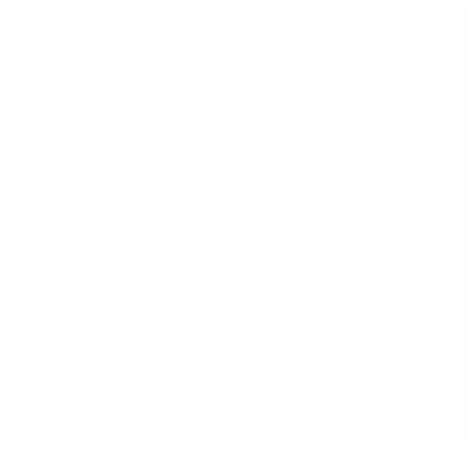
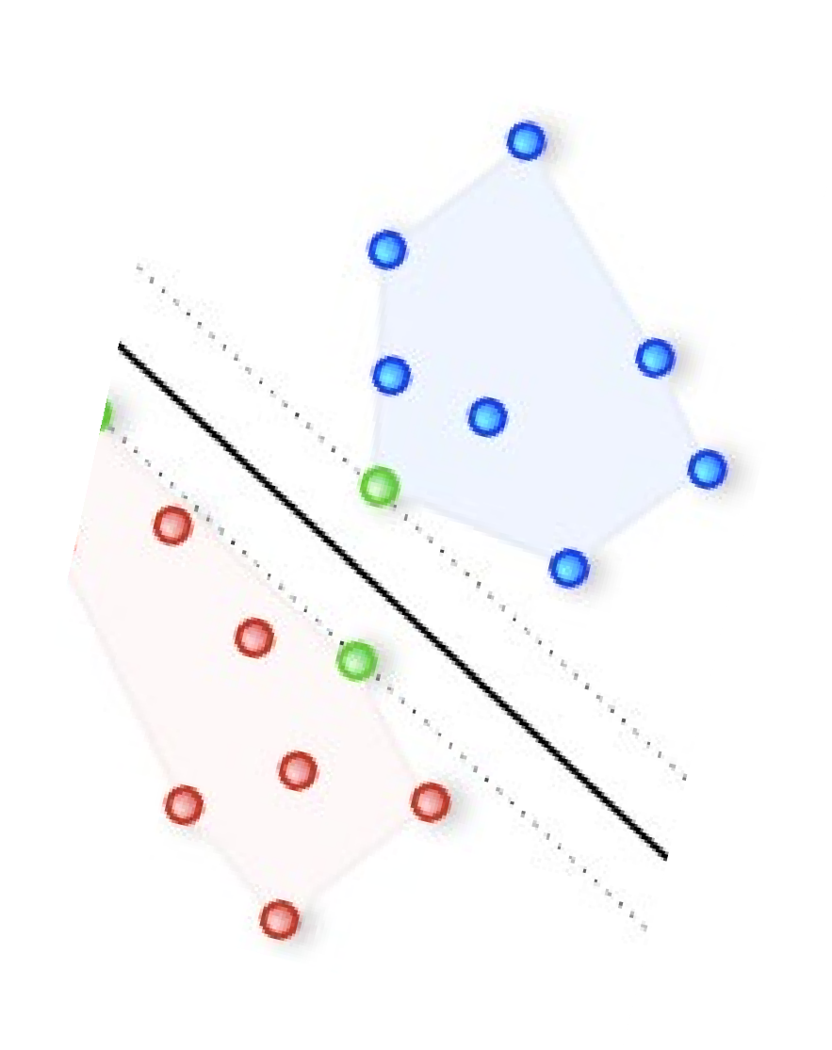
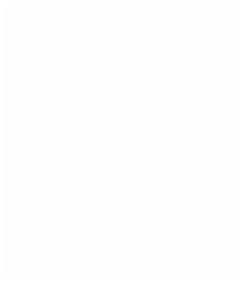
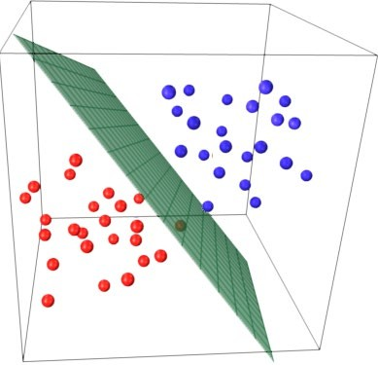











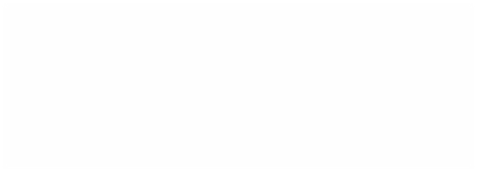

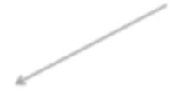


Support Vector Machines
1. Known as maximum-margin hyperplane, find that linear model with max margi. Unlike the linear classifiers, objective is not minimizing sum of squared errors but finding a line/plane that separates two or more groups with maximum margins
Max margin hyper plane
http://stackoverflow.com/questions/9480605/what-is-the- relation-between-the-number-of-support-vectors-and- training-data-and

Slide 2
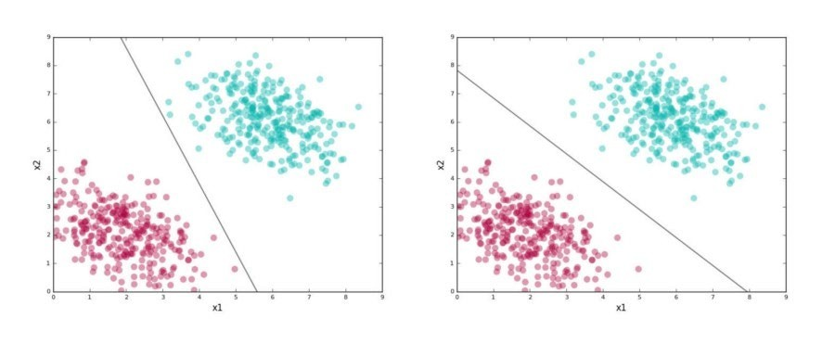
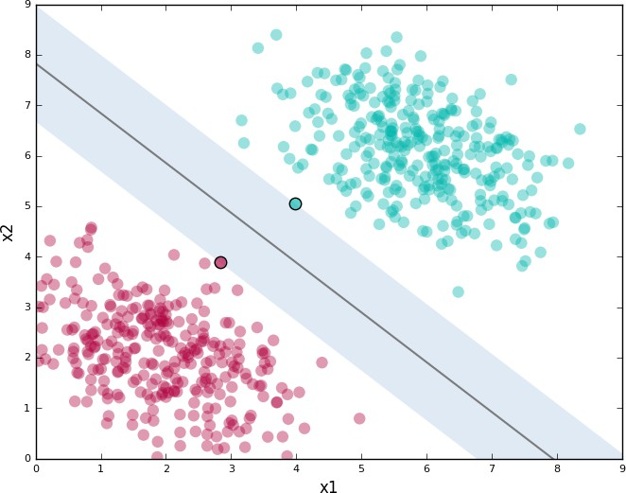
Support Vector Machines
Image Source : https://dzone.com/articles/support-vector-machines-tutorial
First line does separate the two sets but id too close to both red & green data points
Chances are that when this model is put in production, variance in both cluster data may force some data points on wrong side
The second line doesn’t look so vulnerable to the variance. The two points nearest from different clusters define the margin around the line and are support vectors
SVMs try to find the second kind of line where the line is at max distance from both the clusters simultaneously

Slide 3

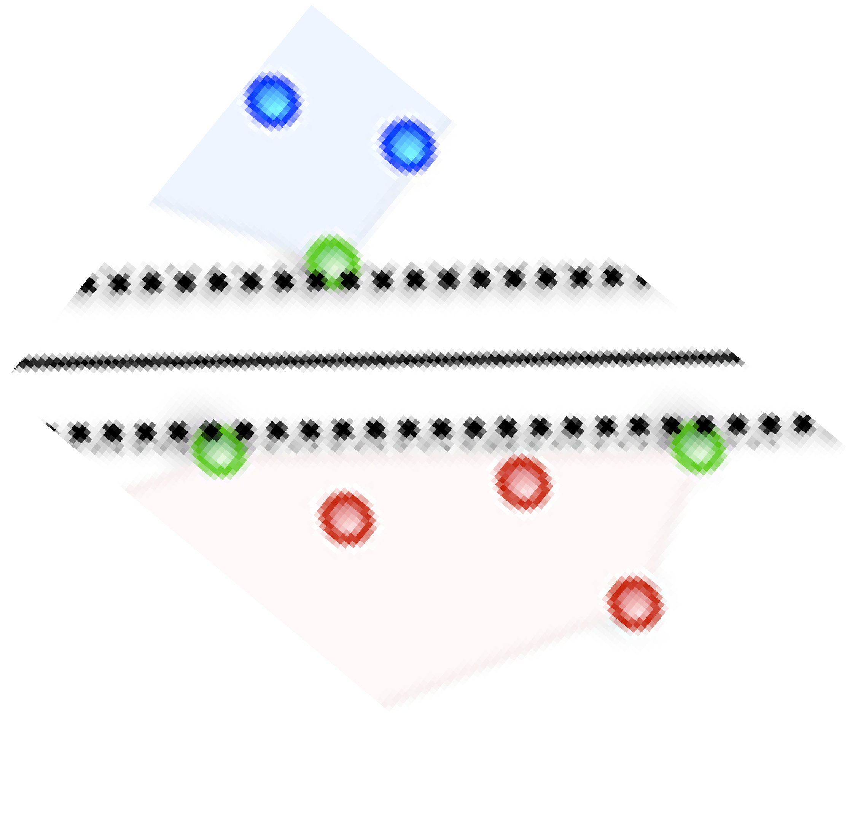
Support Vector Machines
distance from a point(x0,y0) to a line: Ax+By+c = 0 is:
|Ax0 +By0 +c|/sqrt(A^2+B^2)
1
H1
0
H0
-1
H2
d = distance between H0 and H1 is
|w•x+b|/||w||=1/||w||,
The total distance between H1 and H2 is thus: 2/||w||
Think in terms of multi-dimensional space. SVM algorithm has to find the combination of weights across the dimensions such that they hyperplane has max possible margin around it
All the predictor variables have to be numeric and scaled.

Slide 4
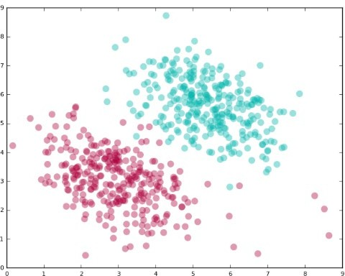
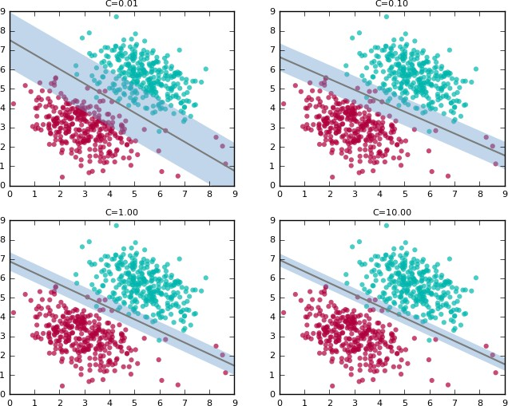
Support Vector Machines Allowing Errors
Image Source : https://dzone.com/articles/support- vector-machines-tutorial
Data in real world is typically not linearly separable.
There will always be instances that a linear classifier can’t get right
SVM provides a complexity parameter, a tradeoff between: wide margin with errors or a tight margin with minimal errors. As C increases, margins become tighter

Slide 5
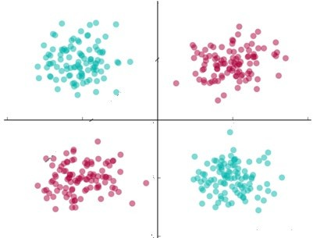
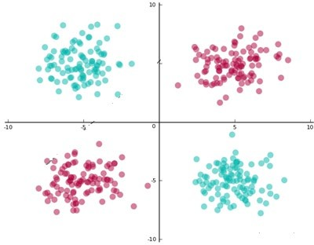


Support Vector Machines Linearly Non Separable Data
x1^2, x2^2
Image Source : https://dzone.com/articles/support vector-machines-tutorial
When data is not linearly separable, SVM uses kernel trick to make it linearly separable
This concept is based on Cover’s theorem “given a set of training data that is not linearly separable, with high probability it can be transformed into a linearly separable training set by projecting it into a higher-dimensional space via some non-linear transformation”
In the pic above, replace x1 with x1^2, x2 with x2^2 and create a third dimension x3 = sqrt(2x1x2)
-

Slide 6
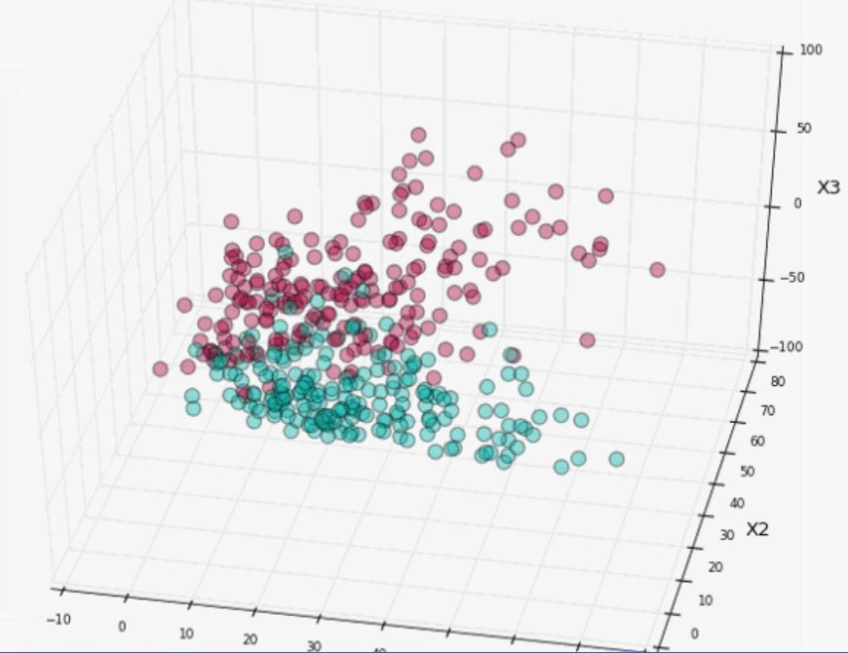
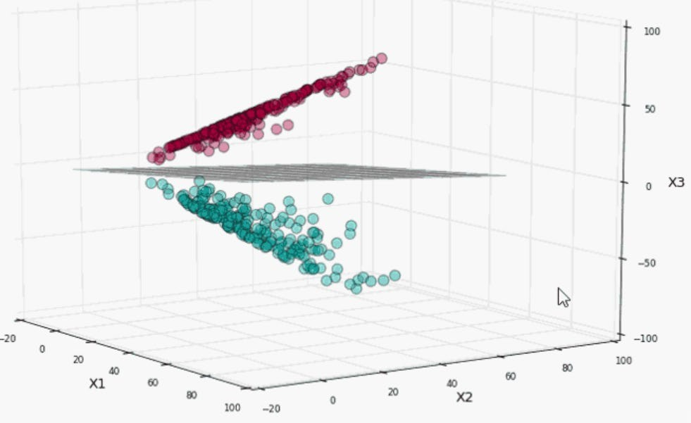
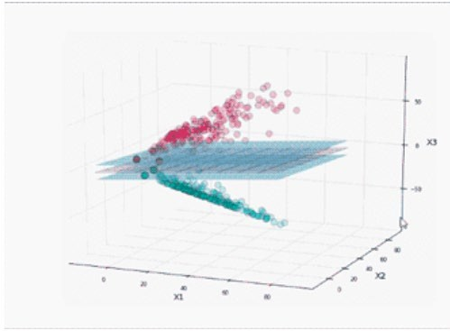
Support Vector Machines Linearly Non Separable Data
Image Source : https://dzone.com/articles/support-vector-machines-tutorial
Using kernel tricks the data points are project to higher dimensional space
The data points become relatively more easily separable in higher dimension space
SVM can now be drawn between the data sets with a given complexity

Slide 7
Support Vector Machines Basic Idea
Suppose we are given training data {(x1, y1),...,(xn, yn) } ⊂ X × R, where X denotes the space of the input patterns (e.g. X = Rd).
Goal is to find a function f(x) that has at most ε deviation from the actually obtained targets yi for all the training data, and at the same time is as flat as possible
In other words, we do not care about errors as long as they are less than ε, but will
not accept any deviation larger than this
f can take the form f(x) = (w, x )+ b with w ∈ X, b ∈ R
Flatness means that one seeks a small w. One way to ensure this is to minimize the
||w||^2 = (w, w).

Slide 8
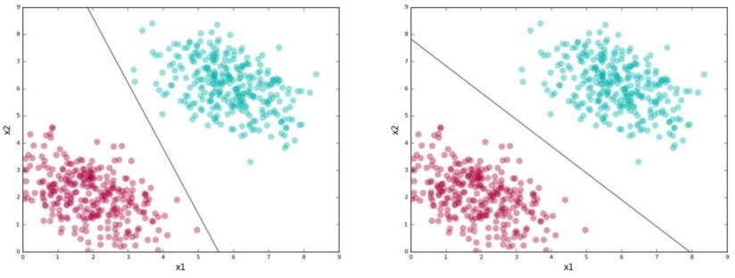



Support Vector Machines Basic Idea
6. The problem can be represented as convex optimization problem
In the first picture, ||w||^2 is not minimized, neither the third constraint. Take the pointer to be x value, yi – (w, xi) – b is < e i.e. diff between green dot and the line but (w, xi) + b –yi i.e. diff between line an red dot is not < e.
In second picture, all three constraints are met
Sometimes, it may not be possible to meet the constraint due to data points not being linearly separable so we may want to allow for some errors.

Slide 9
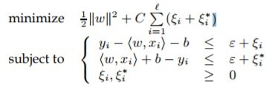
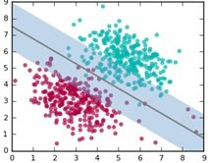
Support Vector Machines Basic Idea
10. We introduce slack variables ξi, ξ∗ i to cope with otherwise infeasible constraints of the optimization problem and this is known as soft margin classifier
11. The epsilon term allows some errors i.e. data points lie within the error margins where error margins is e + epsilon

Slide 10

Support Vector Machines Kernel Functions
SVM libraries come packaged with some standard kernel functions such as polynomial, radial basis function (RBF), and Sigmoid
For degree-d polynomials, the polynomial kernel looks like
where x and y are input vectors in lower dimension space, c is a user specified constant (usually 1). K denotes inner product of x,y in higher dimension space
RBF (Radial Basis Function) kernel on two samples x and x’ is represented as -
4. It ranges from 0 when distance between x and x’ increases (e^-infinity becomes 0) and becomes 1 when x = x’ because x – x’ = 0 and anything raised to 0 is 1

Slide 11
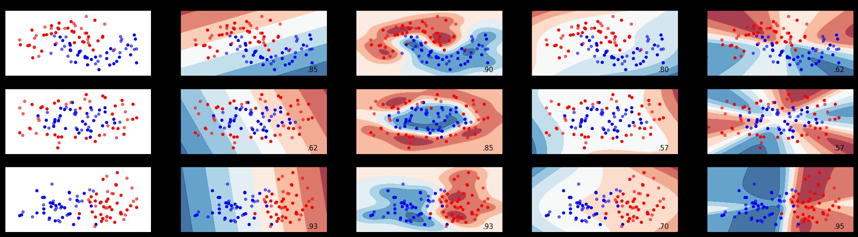
Support Vector Machines Kernel Functions
^{Sigmoid Kernel looks like} K(X,Y)=tanh(γ⋅X(transpose)Y+r)
Linear Kernel are of the form that represents linear equation
Feature space
Linear Kernel
RBF Kernel
Polynomial Kernel
Sigmoid Kernel
Source: https://gist.github.com/WittmannF/60680723ed8dd0cb993051a7448f7805

Slide 12
Machine Learning (Support Vector Machines)
Strengths | Weakness
Very stable as it depends on the support vectors only. Not influenced by any other data point including outliers | Computationally intensive
Can be adapted to classification or numeric prediction problems | Prone to overfitting training data
Capable of modelling relatively more complex patterns than nearly any algorithm | Assumes linear relation between dependent and independent variables
Makes no assumptions about underlying data sets | Generally treated as a blackbox model

